Slide 1

Yuddy wants to get to know new places
But… which ones?

Slide 2
Solution? Recommendation system
Taking other users with similar tastes
Examining which venues have they visited
Finding how similar as Yuddy are they
Obtaining recommendations of places that could fit Yuddys preferences

Slide 3
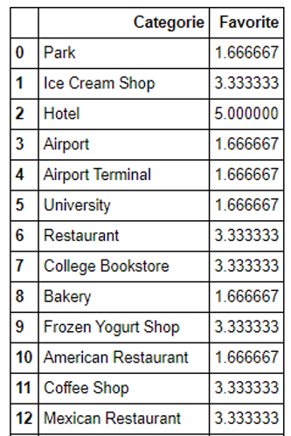
We take Yuddy’s preferences

Slide 4
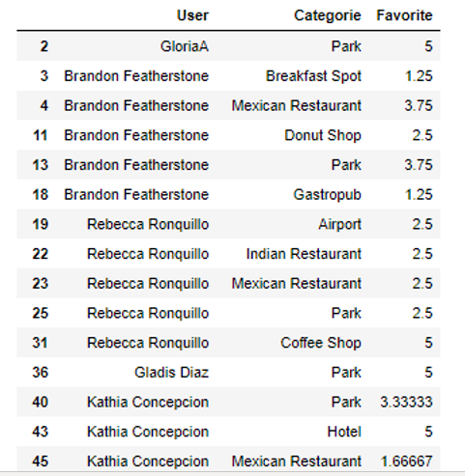
We take other similar user’s preferences

Slide 5
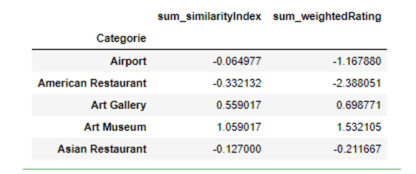
We find the similaritys between each user and Yuddy
By doing so we can construct a weighted similarity venue table

Slide 6
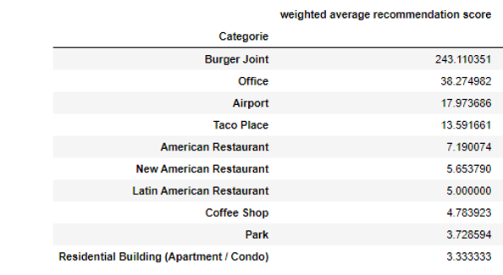
We obtain the recommendations

Slide 7

Enjoy the new places!

